Slide 1









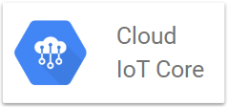





iBeacon devices
BLE
Standard Devices HTTPS
Cloud DNS
Cloud Load Balancing
Cloud CDN
Firewall
Mobile user
Static Content Cloud Storage
Subnet 2 External
Storage
User
Cloud Storage
Cloud Storage
IoT Ingest
Cloud Pub/Sub
iBeacon
Gateway
Bitnami LAMP stack
Analytics
Compute Engine
Compute Engine
BigQuery
Remote Staff
Cloud Interconnect
Cloud IAM
Internal Staff

